Slide 1
Design for Verification Project Update
2021-04-26
Eldrick Millares, Jack Humphries (eldrick, jhumphri@stanford.edu)

Slide 2
Recap:
Completed Deployment on Steel (simple design)
Ongoing Deployment on BOOM (complex design)

Slide 3
Steel Demo - Current Status
All instructions in current SQED generator supported (including load / store)
No counterexamples
Except for when the qed_i_cache eventually gets full and can no longer buffer incoming original instructions

Slide 4
Steel Demo - Summary of Notable Modifications
Disabled CSR MIE
Shrunk Main Memory
Accounted for when `SW` commits in the pipeline
Accounted for multiple commits in one cycle
Accounted for pipeline flushes
Summary of above is in README of the steelcore_demo/ in the Github

Slide 5
Steel Demo - Next Steps
Enabling Control Flow Checking
Can formulate some assertions on the Instruction Address values based on the CFCSS-V and CFTSS-V QED tests
Further references to be found in David Lin’s dissertation
Want to modify SQED Generator to allow these instructions

Slide 6
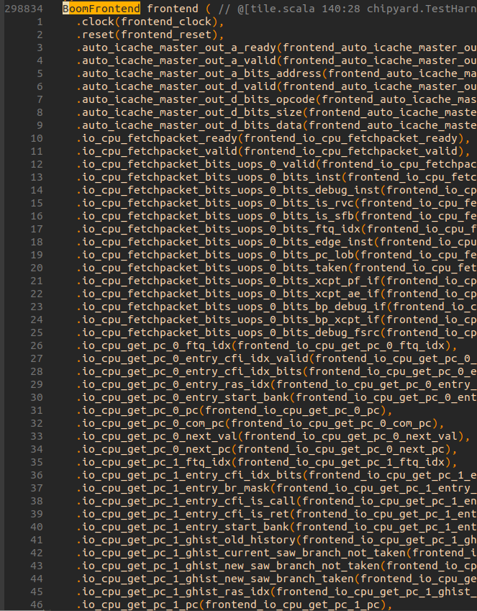
BOOM Demo - Current Status
Starter design committed to repo
Scheduling a meeting with Sneha to help parse the structure of the design

Slide 7
Next Steps Summary
Extend ISA scope in SQED Generator / steel
Deploying QED module to generated BOOM verilog

